Slide 1

The Princess is in Another Document: Intro to Search Engines with Elasticsearch
Isaac Del Rosario (he/him)
@hisaacdelr

Slide 2
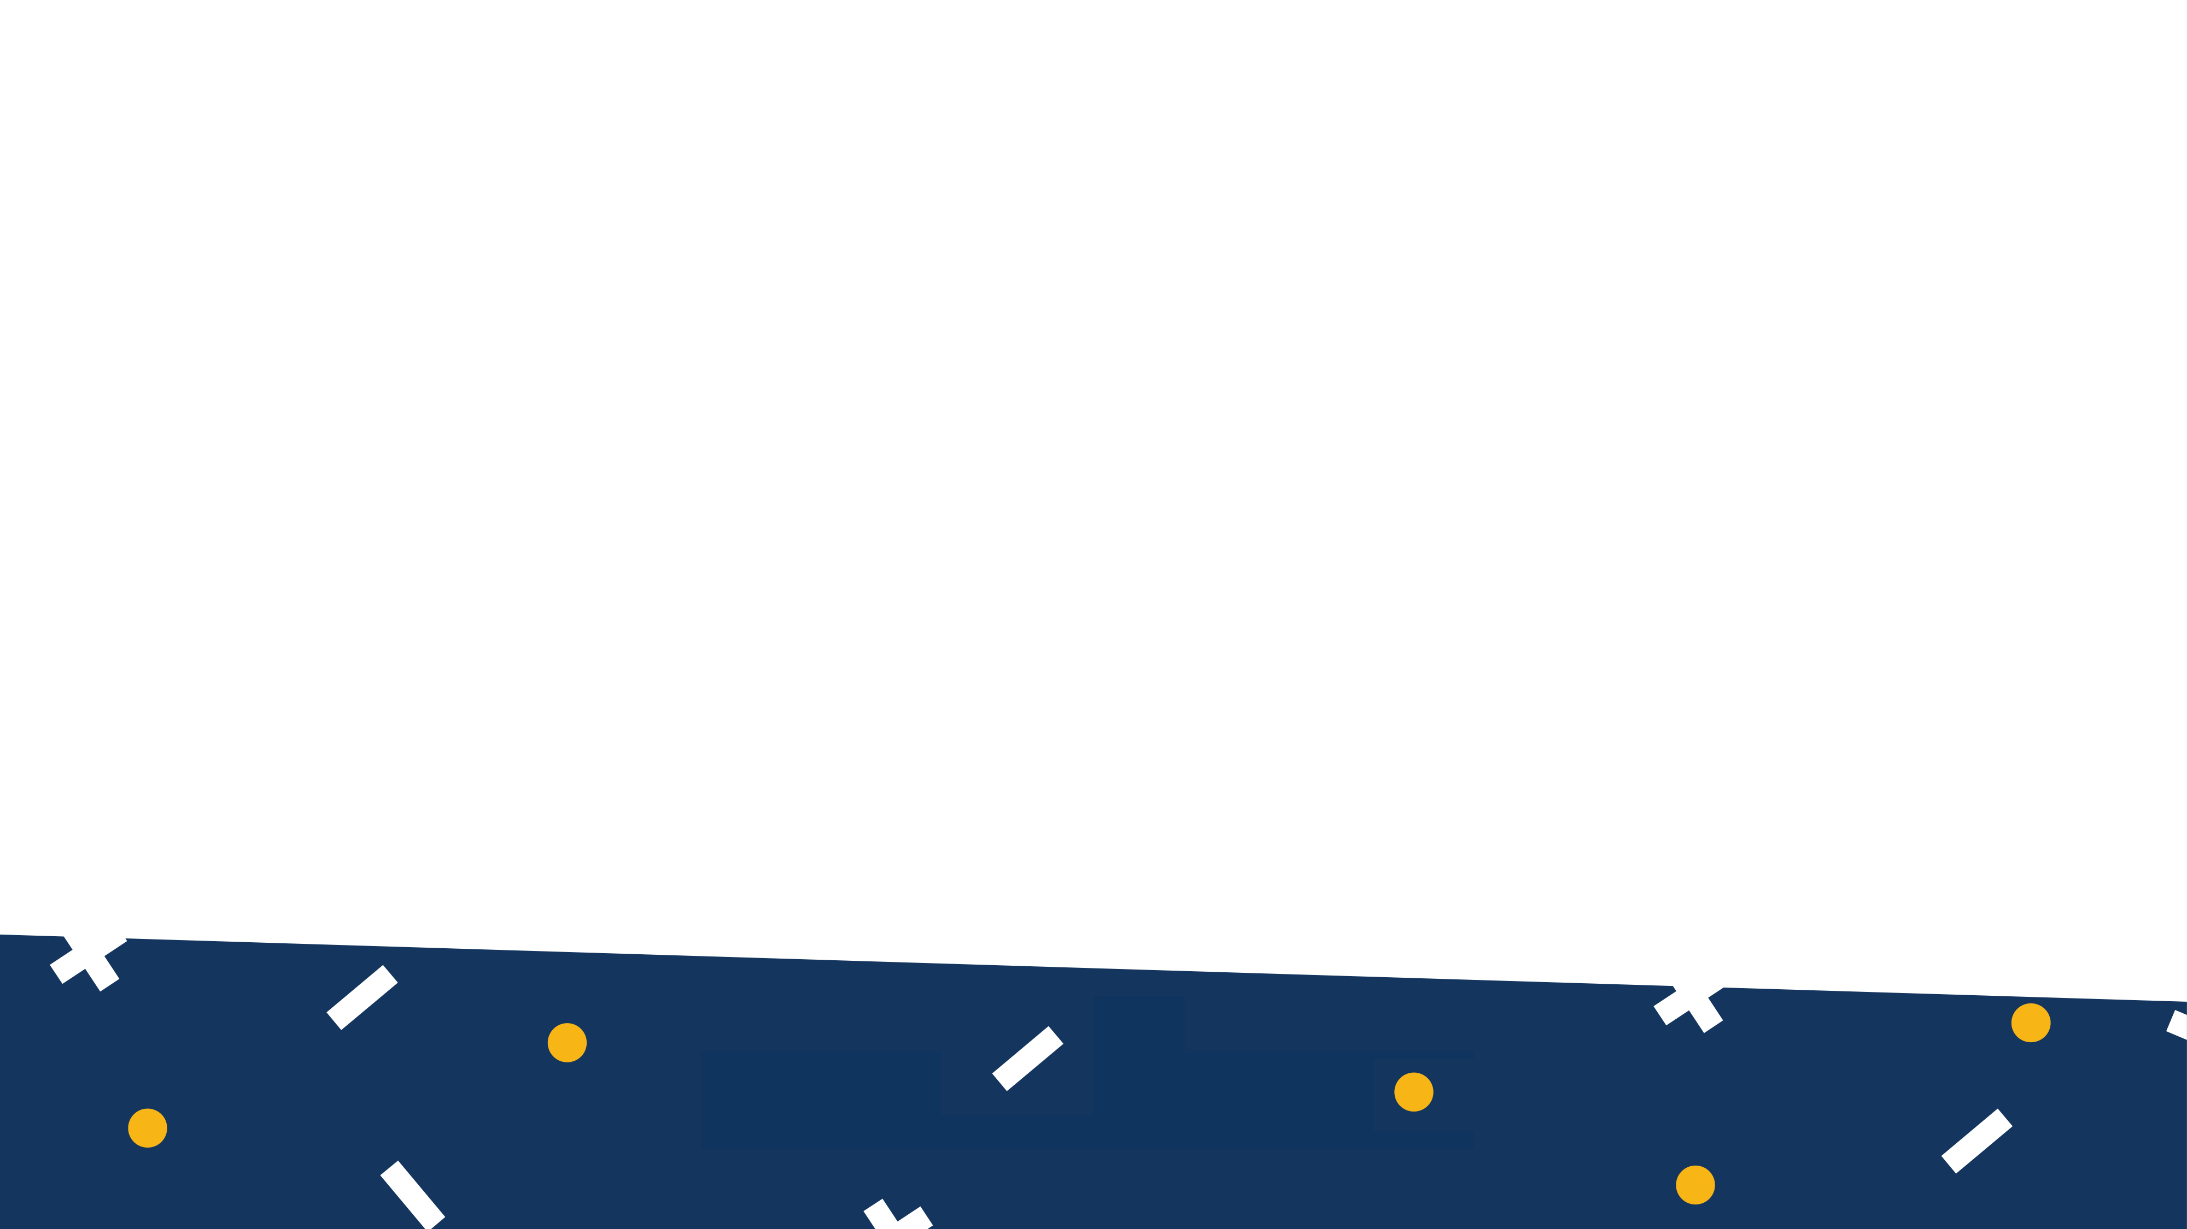

What is a Search Engine?
Software interfacing a database that returns data based on a user’s query
No magic :O
@hisaacdelr

Slide 3
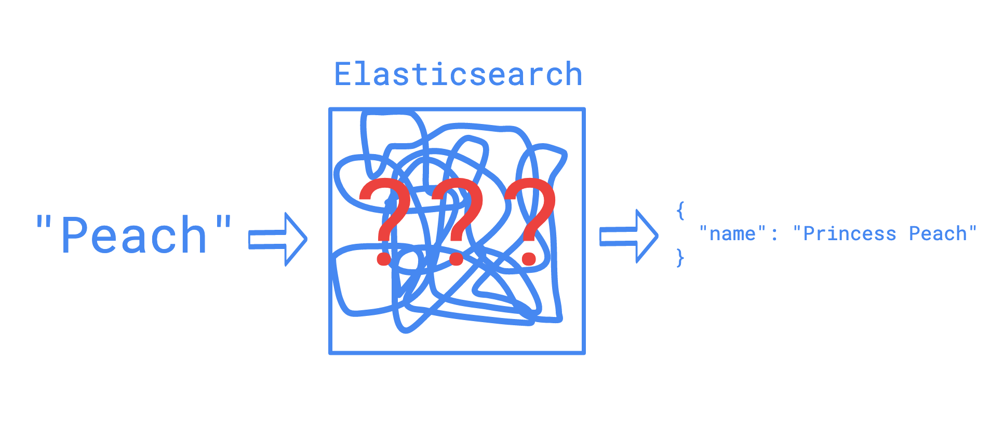
What is a Search Engine?
@hisaacdelr

Slide 4
A Few Elasticsearch Basics
Index
– A collection of documents; similar to a table in a relational DB
Documents
– A JSON document; similar to rows
Mapping
– Schema applied to an entire index
https://www.elastic.co/guide/en/elasticsearch/reference/current/glossary.html
@hisaacdelr
Notes:
Definitions from elasticsearch

Slide 5
Inverted Index
An inverted index is a system wherein a database of text elements is compiled along with pointers to the documents which contain those elements. Ex. An Appendix! - we’re trying to figure out the position of the term vs. a regular index - we’re trying to access the term at the position
@hisaacdelr
Notes:
https://www.deepcrawl.com/knowledge/technical-seo-library/search-engine-indexing/#3
Then, search engines use a process called tokenization to reduce words to their core meaning, thus reducing the amount of resources needed to store and retrieve data. Instead of id=> document, it’s mapping parts of the document to the id parts of documents = > chunks from analyzers

Slide 6
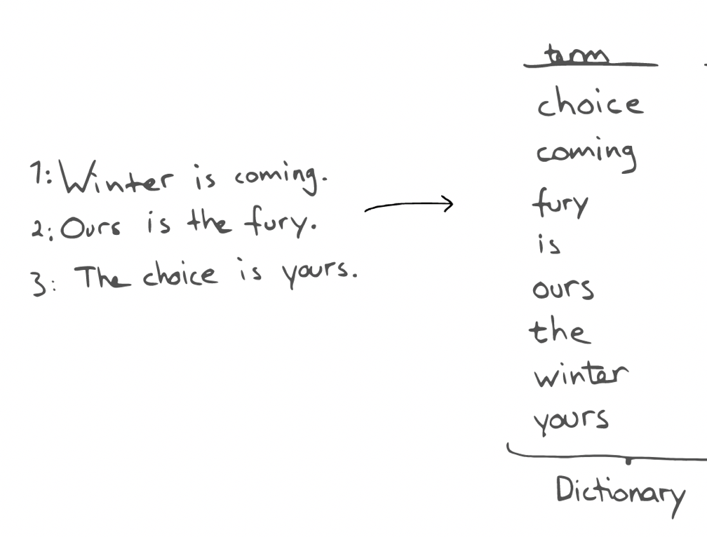
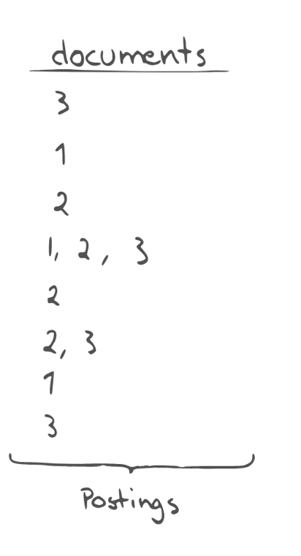
Inverted Index
@hisaacdelr
Notes:
https://www.elastic.co/blog/found-elasticsearch-from-the-bottom-up
Use the id to get document, but here use document to get id Most search engines use TF/IDF as measure of relevancy

Slide 7
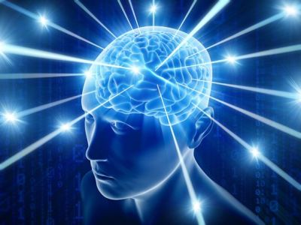
What is a Search Engine?
@hisaacdelr

Slide 8
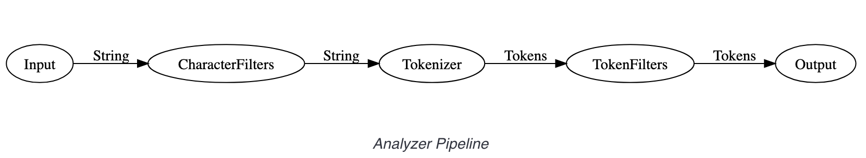
Analyzers
Analyzers – algorithms that determine how to break up documents for the inverted index
@hisaacdelr
Notes:
Search time v. Index time https://www.elastic.co/blog/found-text-analysis-part-1
How to break up documents into smaller term

Slide 9
Tokenization
Breaks down input to tokens
”Quick Fox”
- ngram: edge ngram + [uic, ick, “k F”, “ Fo”]
- whitespace: [Quick, Fox]
- edge ngram: [Qui, Qu, Fox, ox]
@hisaacdelr
Notes:
Token_char What things to include in a token (ex. Letter, digit) means keep only letters and digits, not anything else default: input is ONE BIG token,
- Breaks text down

Slide 10
Token Filters
Removes stop words, apply transformations to tokens from tokenizer
[Qüíck, Föx]
- lowercase: [qüíck, föx]
- asciifolding: [Quick, Fox]
@hisaacdelr

Slide 11
Analyzers: Index v. Search Time
index time = “when we’re adding documents to our index”
search time = “when we make a search query to Elasticsearch”
Why analyze during both times?
Remember! At the end of the day, we’re querying a database! A giant hashmap! We need an exact match key to get a value. Normalizing the structure of the input both from the index and query’s perspective will help us get that exact match
@hisaacdelr
Notes:
https://www.deepcrawl.com/knowledge/technical-seo-library/search-engine-indexing/#3
By default, queries will use the analyzer defined in the field mapping, but this can be overridden with the search_analyzer setting. An example of when a different index and search time analyzer would be useful is to implement auto-complete functionality. Index time: uses edge ngrams, [q, qu, qui, quick, b, br, bro, brown] Search time: standard analyzer (breaks at whitespace and stops) [quick, br] if I type “quick br” https://www.elastic.co/guide/en/elasticsearch/reference/current/search-analyzer.html

Slide 12
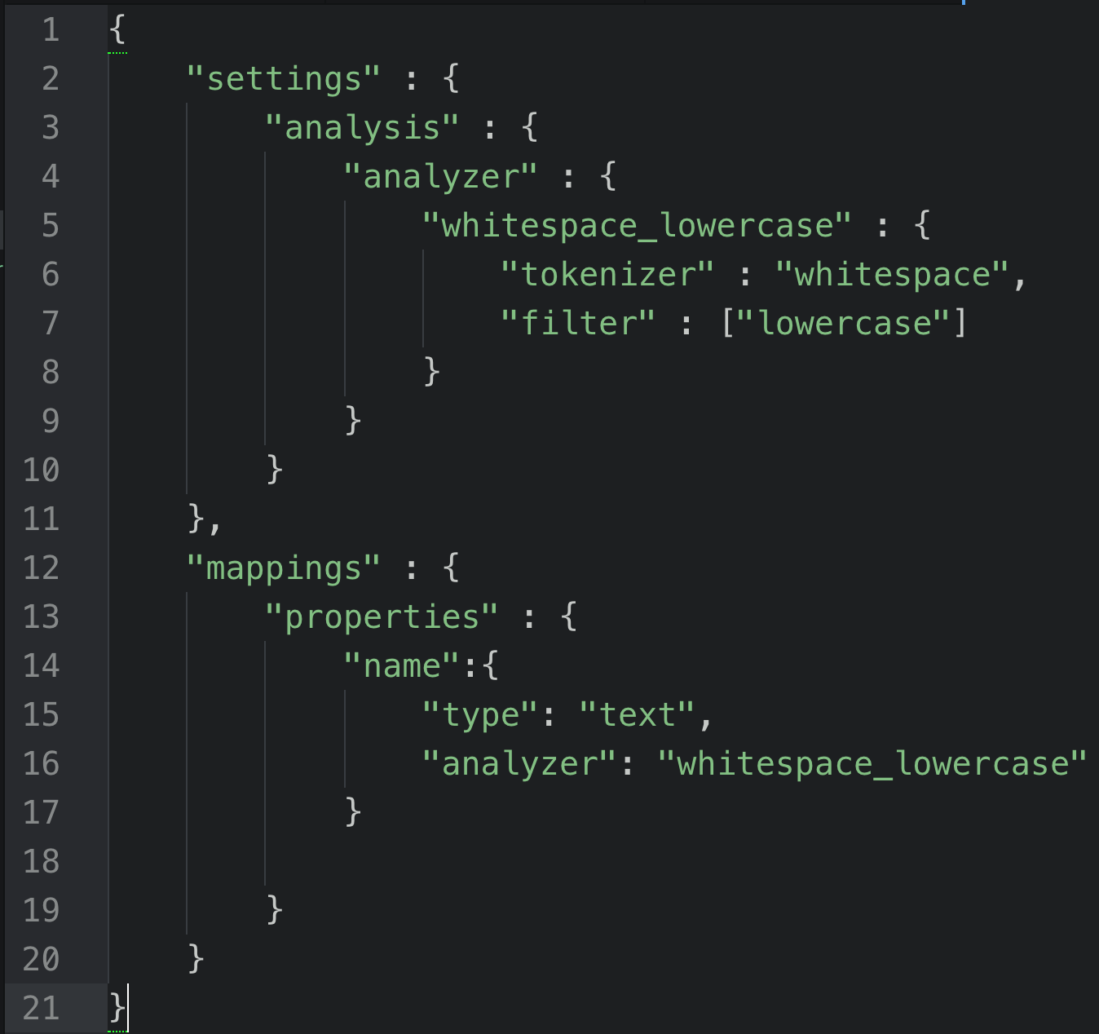
In Practice! Creating the Index
Mapping:
What the mapping does:
Create our own analyzer called whitespace_lowercase
Use a whitespace tokenizer on the input
Apply a lowercase token filter to the tokens
Set our analyzer to be used on the “name” field of each document in the index
@hisaacdelr
Notes:
https://www.deepcrawl.com/knowledge/technical-seo-library/search-engine-indexing/#3
Then, search engines use a process called tokenization to reduce words to their core meaning, thus reducing the amount of resources needed to store and retrieve data.

Slide 13
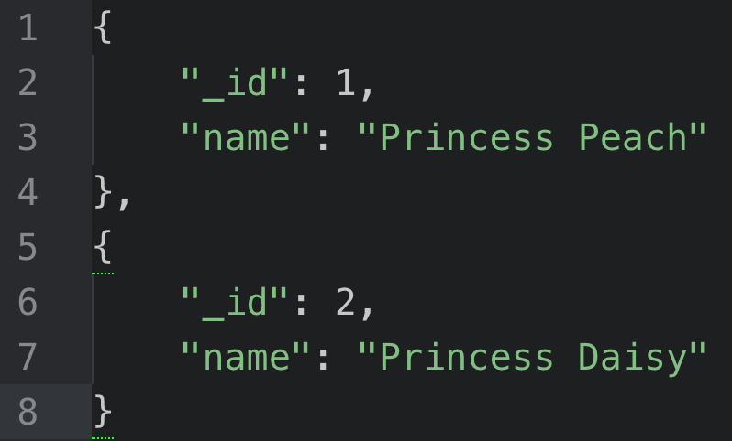
In Practice! Adding Documents
Terms | Doc ID | # of times term occurs (frequency)
“princess” | 1, 2 | 2
“peach” | 1 | 1
“daisy” | 2 | 1
POST
@hisaacdelr
Notes:
https://www.deepcrawl.com/knowledge/technical-seo-library/search-engine-indexing/#3
Then, search engines use a process called tokenization to reduce words to their core meaning, thus reducing the amount of resources needed to store and retrieve data. *segue into TF/IDF* add the ngrams, refer to last slide

Slide 14
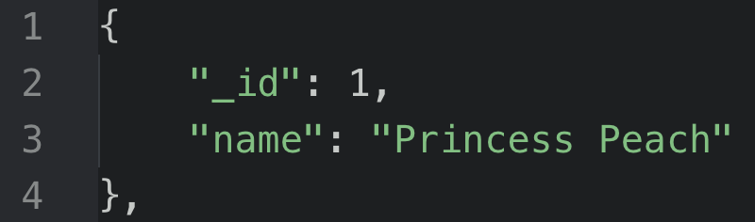
In Practice! Searching for…
“Peach” lowercases it and finds it in inverted index
“Pea” From n-grams “beach”
Fuzzy search in the query
Target Document:
@hisaacdelr
Notes:
https://www.deepcrawl.com/knowledge/technical-seo-library/search-engine-indexing/#3
Then, search engines use a process called tokenization to reduce words to their core meaning, thus reducing the amount of resources needed to store and retrieve data.
Put illustration of inverted index

Slide 15


Demo
+ Questions? ? ?

Slide 16
Bonus Round…? TFIDF
“Term Frequency, Inverse Document Frequency” TF: measures how frequently a term occurs in a document
TF(t) = (# of times term t appears in a document) ÷ (Total # of terms in the document)
IDF: measures how important a term is
IDF(t) = log_{e}(Total # of documents ÷ Number of documents with term t in it). Relevance Score = TF * IDF
Definitions from: http://www.tfidf.com/
@hisaacdelr
Notes:
https://www.deepcrawl.com/knowledge/technical-seo-library/search-engine-indexing/#3
Then, search engines use a process called tokenization to reduce words to their core meaning, thus reducing the amount of resources needed to store and retrieve data.
Put illustration of inverted index

